Slide 1
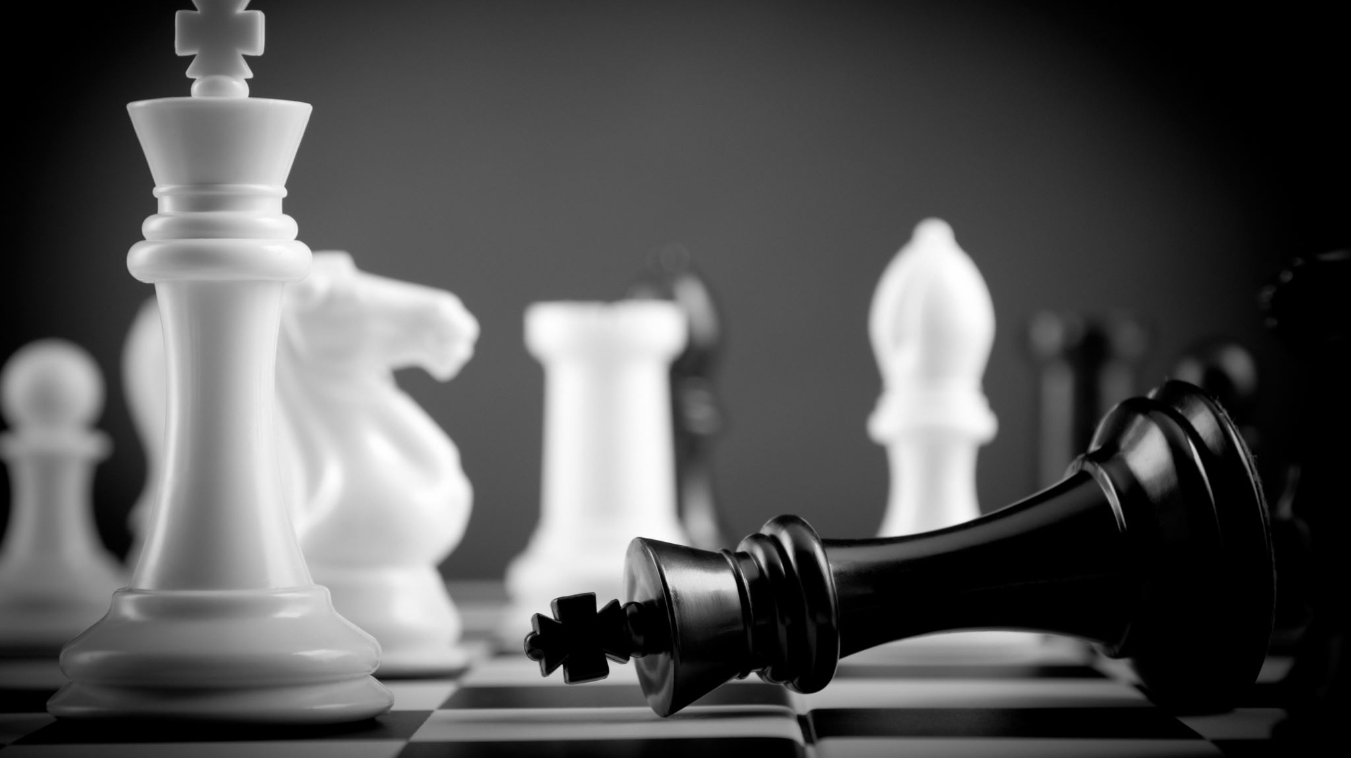
Chess Engine Optimisation using Naïve Bayes Progress Update 2
Mohammad Ibrahim Khan
k22013981

Slide 2
Progress
I have done research on chess and how modern techniques are used for chess including mini-max and alpha beta pruning, I now have a better understanding of how chess works.
I also did research on what Naïve Bayes is and how it works as a classifier. I compiled a number of papers on the topic and had a read of some of these papers. To help with understanding I also implemented a version of Naïve Bayes to a dataset on breast cancer data.

Slide 3
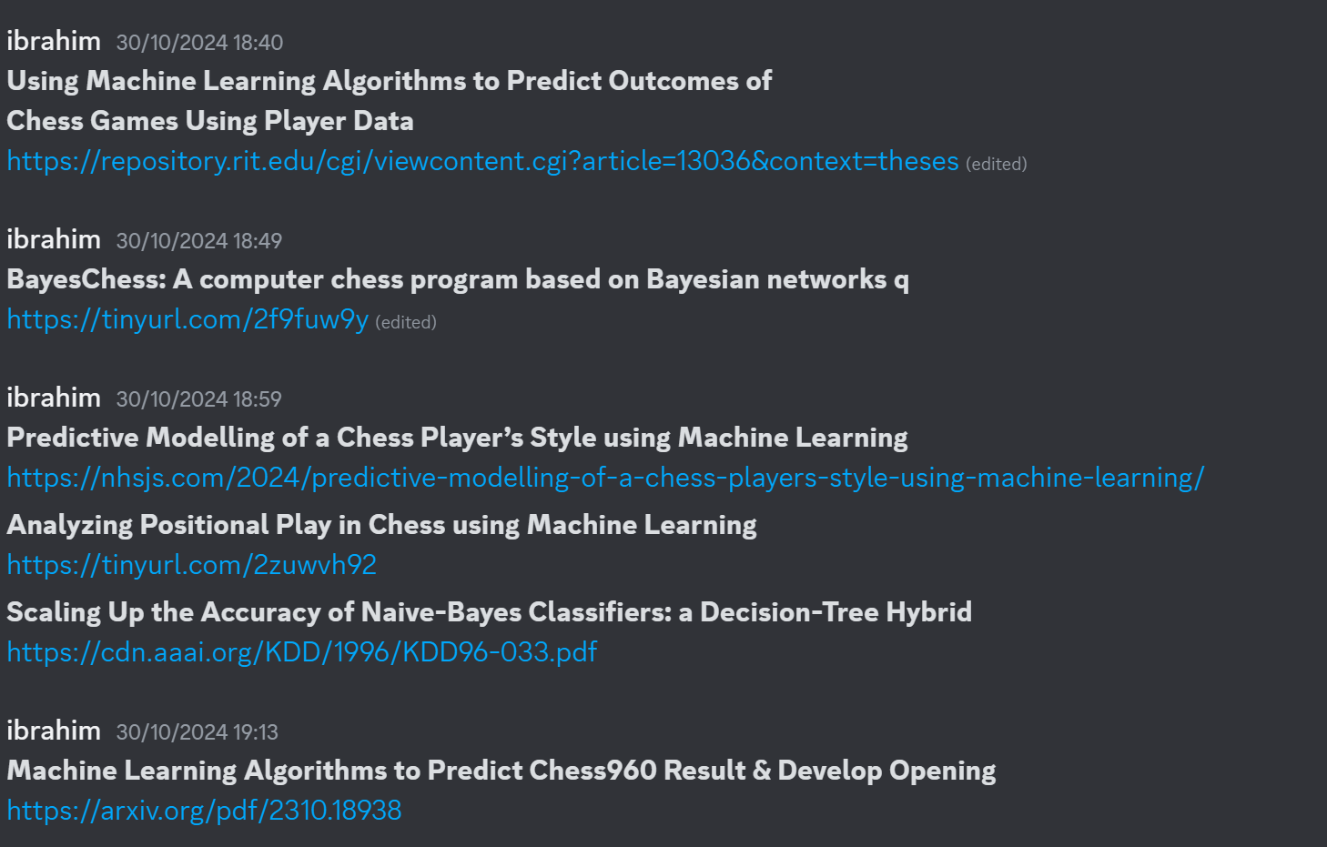
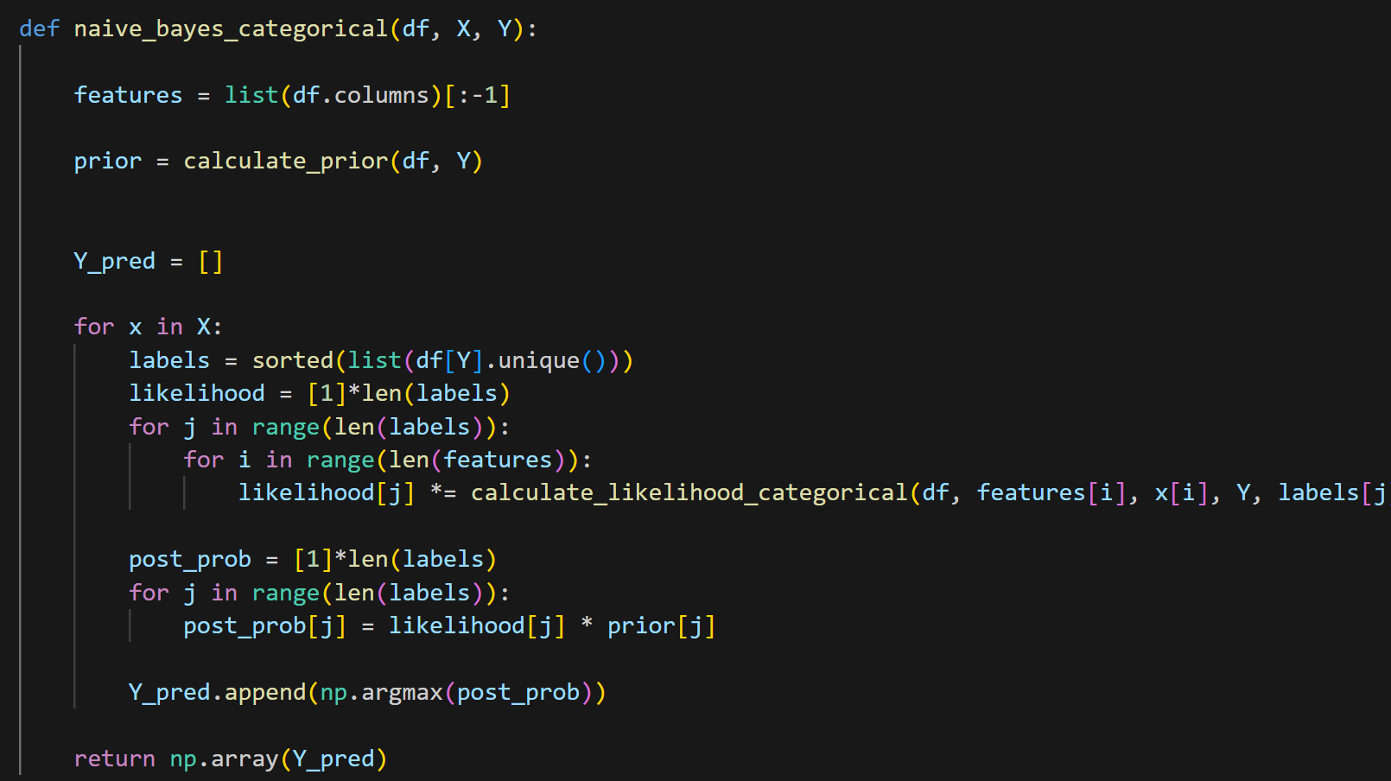
Update Snippets

Slide 4
Next Steps
Now I need to find a good chess dataset to use for Naïve Bayes
Then I need to preprocess this data to make it fit for Naïve Bayes
Then use this data to make a Naïve Bayes Classifier.

